Slide 1
Pulmonary Hypertension:
Comorbidities With PAH and Group 2 PH
Bradley A. Maron, MD
Director, Scientific Operations
The University of Maryland-IHC
North Bethesda, MD

Slide 2
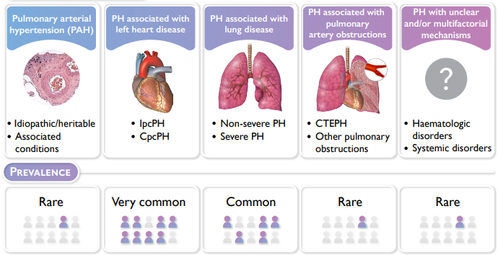
Pulmonary Hypertension Nomenclature
Approach to
Pulmonary Hypertension (PH)
Clinical Acumen
Physical Examination
Echocardiography
Lung function
Hemodynamics
Clinical Profile
PH Classification
40% Overlap Two Groups
Risk Stratification
Appropriate Treatment
Humbert M, et al. Eur Respir J. 2023;61(1):2200879.

Slide 3
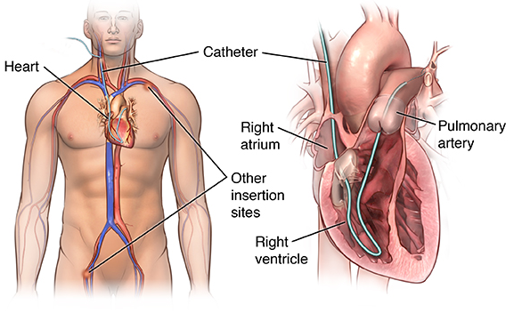
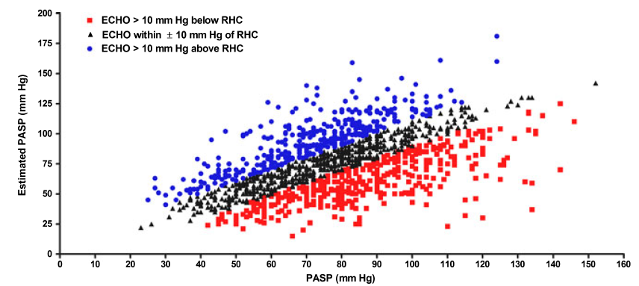
Early and Accurate Diagnosis
Echocardiography
Right Heart Catheterization
Estimated Pulmonary
Artery Systolic Pressure
PA Pressure
PA Wedge Pressure
Cardiac Output
Pulmonary Vascular Resistance
ECHO >10 mmHg below RHC
Right Ventricular Function
ECHO within ±10 mmHg RHC
ECHO >10 mmHg above RHC
Estimated PASP
by ECHO (mmHg)
RHC Required for Diagnosis
PASP by Catheterization (mmHg)
Farber HW, et al. Congest Heart Fail. 2011;17(2):56-64.

Slide 4
Early and Accurate Diagnosis
Mean PA Pressure
PVR
6
mPAP
19-24 mmHg
Classical PH
(mPAP ≥25 mmHg)
5
4
Mortality Hazard Ratio
Classic Threshold
Mortality Hazard Ratio
3
PVR 2.0
3 WU
2
1
10
20
30
40
50
60
mPAP (mmHg)
PVR (Wood units)
Maron BA, et al. Circulation. 2016;133(13):1240-1248.
Maron BA, et al. Lancet Respir Med. 2020;8(9):873-884.

Slide 5
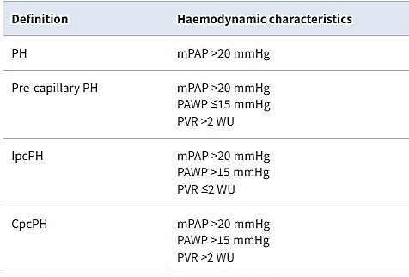
Hemodynamic Classification of PH
2022 ESC/ERS PH Guidelines
CpcPH, Combined pre-/post-capillary pulmonary hypertension;
IpcPH, Isolated post-capillary pulmonary hypertension.
Notes:
Therefore, a new mission was born toward recalibrating the hemodynamic framework of PH, with particularly emphasis on delineating the PVR threshold that may provide an optimal specificity of PH diagnostically, while allowing for consideration to early diagnosis. This effort has already been underway…Xanthouli and colleagues analyzed prospectively and consecutively 284 patients with SSc referred for PAH screening in Heidelberg and Zurich. Thy observed that ~20% of patients had mPAP 21-24 mmHg, but that very few of these patients had PVR >/= 3.0 WU. By contrast, >50% of patients with mPAP 19-24 mmHg and 62% of patients with mPAP >/=25 mmHg had PVR of at least 2.0 WU. Compared to those patients with PVR <2.0, patients in this analysis with PVR at least 2.0 WU had significantly lower 6MWD and all-cause higher mortality risk. This raised the possibility that PVR <3.0 WU could be important clinically, but data on the continuum of PVR risk from sufficiently powered clinical studies remained lacking.

Slide 6
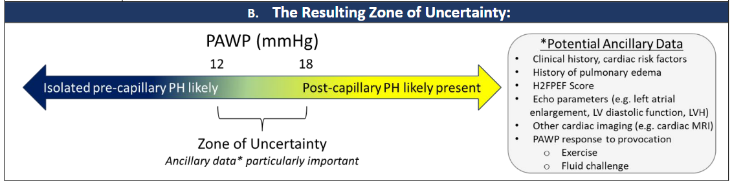
Sources of Imprecision
Zero-reference level
Transmitted intrathoracic pressure
Effects of the respiratory cycle
Use of breath arrest maneuvers
Effects of cardiac cycle
Presence of large V-waves
Incomplete pulmonary arterial
occlusion
Patient volume status
Ventricular interdependence
Rayner SG, et al. Am J Respir Crit Care Med. 2024;210(6):712-714.
Notes:
These collective data have caused reconsideration to the timing of right heart catheterization. This is particularly important in patients who are likely to present initially with postcapillary pulmonary hypertension. In that subgroup complete diuresis before right heart catheterization may have important implications on the hemodynamic classification of pulmonary hypertension as well as prognosis. This is not addressed by the traditional approach to right heart catheterization in which conventional indications and risk factors are used to support performing a hemodynamic study without guidance on standardization of the timing of the procedure. Our group recently proposed some modifications to this approach including some contemporary indications such as unexplained dyspnea or unexplained right ventricular dysfunction, among others. In this model, right heart catheterization is performed prior to complete diuresis if this can be done safely. We believe this simple adjustment is likely to have a large impact on the accuracy of PH diagnosis, and therefore the probability of appropriate risk stratification and treatment.

Slide 7
Timing or RHC in the Diagnosis of PH
65 y.o. man with HTN and obesity in clinic for progressive dyspnea
Diuresis
Referred for RHC
↓5 kg
Referred for RHC
mPAP, 38 mmHg
PVR, 2.5 WU
PAWP, 11 mmHg
mPAP, 38 mmHg
PVR, 2.5 WU
PAWP, 28 mmHg
Precapillary PH
?
CpC-PH
Notes:
These collective data have caused reconsideration to the timing of right heart catheterization. This is particularly important in patients who are likely to present initially with postcapillary pulmonary hypertension. In that subgroup complete diuresis before right heart catheterization may have important implications on the hemodynamic classification of pulmonary hypertension as well as prognosis. This is not addressed by the traditional approach to right heart catheterization in which conventional indications and risk factors are used to support performing a hemodynamic study without guidance on standardization of the timing of the procedure. Our group recently proposed some modifications to this approach including some contemporary indications such as unexplained dyspnea or unexplained right ventricular dysfunction, among others. In this model, right heart catheterization is performed prior to complete diuresis if this can be done safely. We believe this simple adjustment is likely to have a large impact on the accuracy of PH diagnosis, and therefore the probability of appropriate risk stratification and treatment.

Slide 8
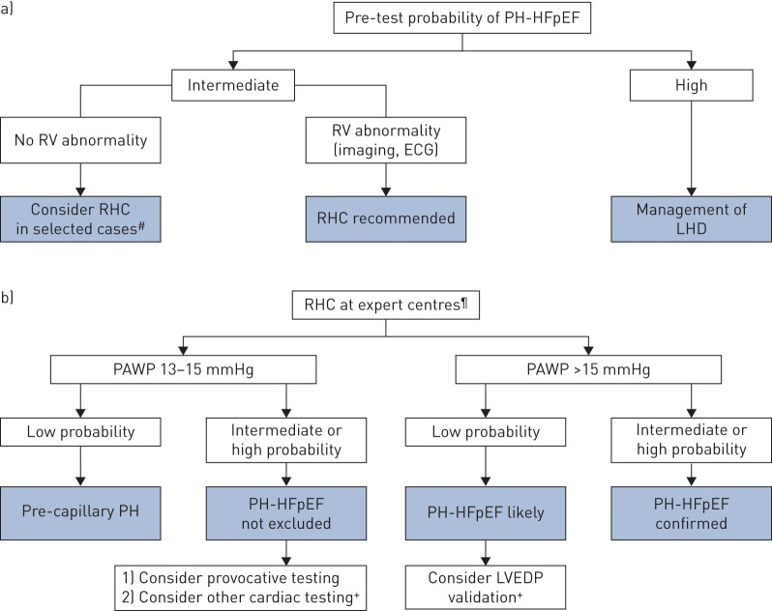
Provoking Left Heart Disease-PH
Contemporary Considerations
Pre-test Probability:
H2FpEF and HFA-PEFF scores
Staging LHD comorbidities*
Provocative testing:
Relevant even if PAWP <13 mmHg
Reddy YNV, et al. JAMA Cardiol. 2022;7(9):891-899. Baratto C, et al. Circ Heart Fail. 2021;14(5) e007555.
Vachiéry JL, et al. Eur Respir J. 2019;53(1):1801897.
Notes:
These collective data have caused reconsideration to the timing of right heart catheterization. This is particularly important in patients who are likely to present initially with postcapillary pulmonary hypertension. In that subgroup complete diuresis before right heart catheterization may have important implications on the hemodynamic classification of pulmonary hypertension as well as prognosis. This is not addressed by the traditional approach to right heart catheterization in which conventional indications and risk factors are used to support performing a hemodynamic study without guidance on standardization of the timing of the procedure. Our group recently proposed some modifications to this approach including some contemporary indications such as unexplained dyspnea or unexplained right ventricular dysfunction, among others. In this model, right heart catheterization is performed prior to complete diuresis if this can be done safely. We believe this simple adjustment is likely to have a large impact on the accuracy of PH diagnosis, and therefore the probability of appropriate risk stratification and treatment.

Slide 9
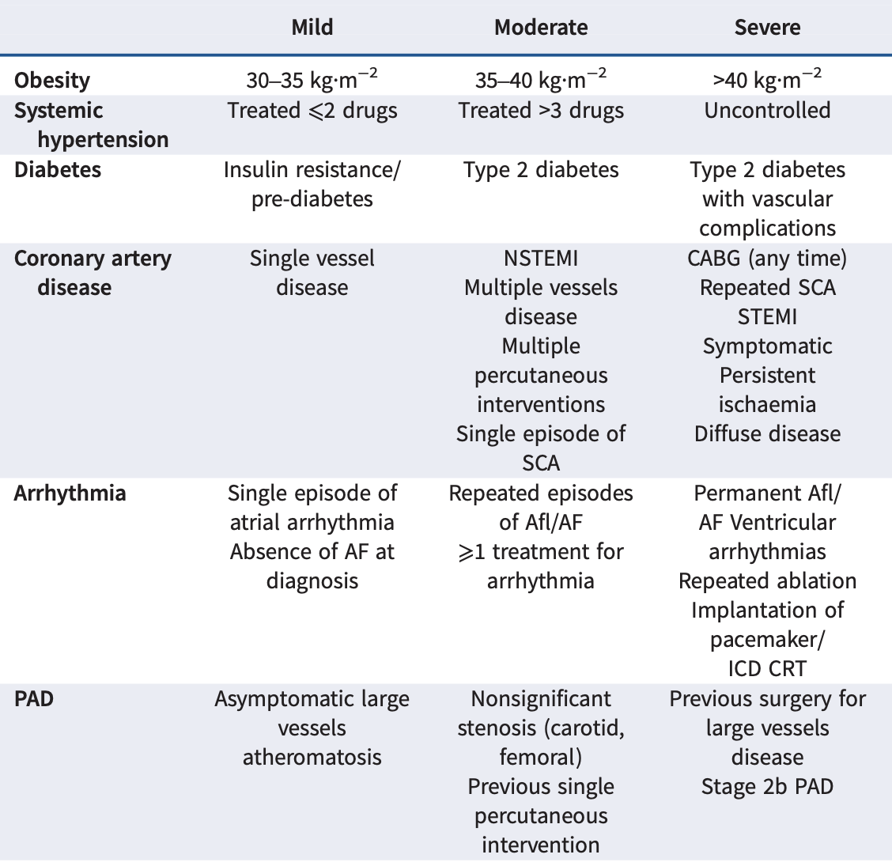

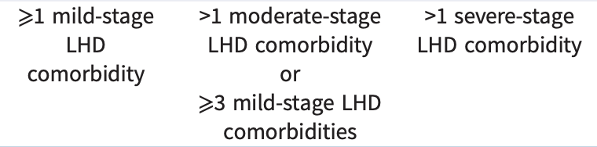
Assessing Probability of Left Heart Disease-PH
Maron BA, et al. Eur Respir J. Published online August 29, 2024. doi:0.1183/13993003.01344-2024
Notes:
These collective data have caused reconsideration to the timing of right heart catheterization. This is particularly important in patients who are likely to present initially with postcapillary pulmonary hypertension. In that subgroup complete diuresis before right heart catheterization may have important implications on the hemodynamic classification of pulmonary hypertension as well as prognosis. This is not addressed by the traditional approach to right heart catheterization in which conventional indications and risk factors are used to support performing a hemodynamic study without guidance on standardization of the timing of the procedure. Our group recently proposed some modifications to this approach including some contemporary indications such as unexplained dyspnea or unexplained right ventricular dysfunction, among others. In this model, right heart catheterization is performed prior to complete diuresis if this can be done safely. We believe this simple adjustment is likely to have a large impact on the accuracy of PH diagnosis, and therefore the probability of appropriate risk stratification and treatment.

Slide 10
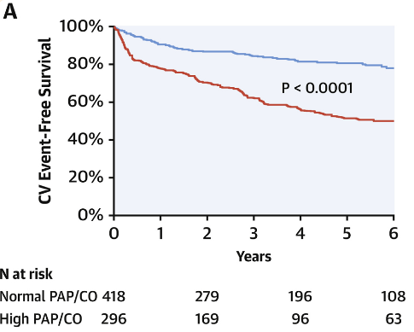
Exercise Hemodynamics and Prognostication in PH
Dyspnea with Preserved EF
Undifferentiated Dyspnea, Normal RHC Results at Rest
≤3 mmHg/L/min
 | mPAP/CO | PAWP/CO
Pulmonary Vascular Disease | >3 mmHg/L/min | <2 mmHg/L/min
Left heart disease-PH | >3 mmHg/L/min | >2 mmHg/L/min (or PAWP >25 mmHg
>3 mmHg/L/min
Ho JE, et al. J Am Coll Cardiol. 2020;75(1):17-26.

Slide 11
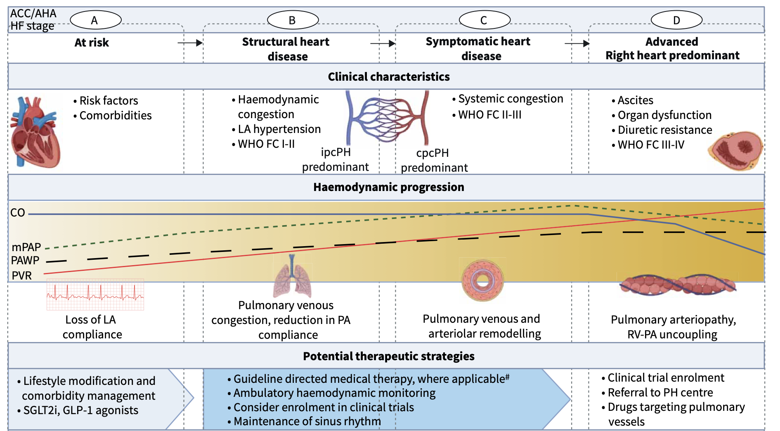
Stages of Left Heart Disease-PH

Slide 12
Stages of Left Heart Disease-PH

Slide 13
Stages of Left Heart Disease-PH

Slide 14
Stages of Left Heart Disease-PH

Slide 15
Summary and Conclusions
The hemodynamic definition for PH has changed to mPAP >20 mmHg and PVR >2.0 WU, which emphasizes early-stage diagnosis.
Delineating PAH from left heart disease-PH can be challenging in clinical practice.
Risk scores as well as fluid challenge or exercise during RHC may be helpful for diagnosing left heart disease-PH, but standardized protocols are lacking.
RHC results require consideration of comorbidities and volume status, particularly when the pulmonary artery wedge pressure is in the zone of uncertainty (12-18 mmHg).

