Slide 1
Management of PAH With Comorbidities
Vallerie McLaughlin, MD
Professor, Internal Medicine
University of Michigan
Ann Arbor, MI

Slide 2
ESC/ERS: Treatment of Patients With I/H/D PAH or PAH-CTD
Diagnosis confirmed at PH center, vasoreactivity testing negative
Newest treatment add-on: activin signaling inhibition. Look for updated 7WS algorithm in fall 2024
General measures throughout the course of the disease
(Class I)
Patient without cardiopulmonary comorbidities
Patient with cardiopulmonary comorbidities
All risk categories
Risk (3 strata)
❓
Low or intermediate
High
Initial ERA + PDE5i therapy
(Class I)
Initial ERA + PDE5i therapy
and IV/SC PCA (Class IIa)
Initial oral monotherapy with PDE5i or ERA
(Class IIa)
Regular follow-up assessment
Regular follow-up assessment
and individualized therapy
Risk (4 strata)
Low
Intermediate low
Intermediate high or high
Continue initial therapy
(Class I)
Add PRA
(Class IIb)
or
Switch from PDE5i to SGC (Class IIb)
Add IV or SC PCA and/or evaluate
for lung transplantation (Class IIa)
Humbert M, et al. Eur Heart J. 2022;43(38):3618-3731. Humbert M, et al. Eur Respir J. 2023;61(1):2200879.
Notes:
Add-on

Slide 3
REVEAL Registry Analysis:
Prognostic Factors
FC I
FC II
FC III
FC IV
Subjects with Group 1 PAH with any comorbidity had worse FC and 6MWD
Poms AD, et al. Chest. 2013;144(1):169-176.
Notes:
6MWD, 6-minute walking distance; COPD, chronic obstructive pulmonary disease; FC, functional class.

Slide 4
Prevalence of Cardiopulmonary Comorbid Conditions in PH: French PH Registry
60% of patients with PAH have at least one…
≥2
CV comorbidity
1
CV comorbidity
No
CV comorbidities
CV comorbidities
Slide courtesy of Olivier Sitbon, MD, French PH Registry data on file.

Slide 5
Do Cardiopulmonary Comorbidities in PH Affect Outcomes?
Idiopathic PAH phenotypes determined by cluster analysis from the COMPERA registry
Cluster 1
Cluster 2
Cluster 3
n = 106 (13%)
n = 301 (36%)
n = 301 (51%)
Mean age: 45 y
No comorbidity
Female predominance (76%)
DLCO >45%
Mean age: 75 y
CV comorbidities (94%)
Female (98%) – AF (36%)
DLCO <45% (34%)
Mean age: 72 y
CV comorbidities (91%)
Males (78%) – smokers (79%)
DLCO <45% (53%)
Adapted from Hoeper MM, et al. J Heart Lung Transplant. 2020:39(12):1435-1444.

Slide 6
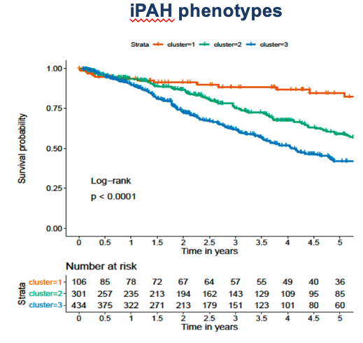
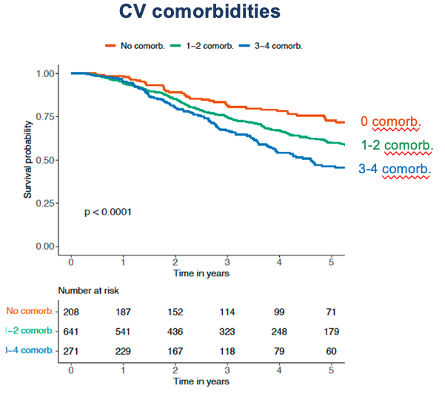
Do Cardiopulmonary Comorbidities in PH Affect Outcomes?
Hoeper MM, et al. J Heart Lung Transplant. 2020:39(12):1435-1444.
Rosenkranz S, et al. J Heart Lung Transplant. 2023;42(1):102-114.

Slide 7
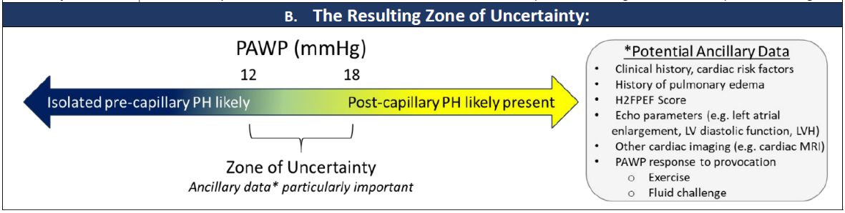
Zone of Uncertainty:
Pulmonary Arterial Wedge Pressure
methodological & clinical factors
“PAWP should always be considered within the clinical context for appropriate classification of PH and for optimal decision-making regarding the management of patients.”
Rayner SG, et al. Am J Respir Crit Care Med. 2024;210(6):712-714. ​

Slide 8
AMBITION: With and Without CV Risk Factors
(A) Primary Analysis Set
(B) Ex-Primary Analysis Set
Combination therapy
Combination therapy
Participants With No Event (%)
Participants With No Event (%)
Pooled monotherapy
Pooled monotherapy
Hazard ratio, 0.50 (95% CI, 0.35-0.72)
P < 0.001
Hazard ratio, 0.70 (95% CI, 0.35-1.37)
No. at Risk
No. at Risk
Combination therapy | 253 | 229 | 168 | 145 | 106 | 71 | 36 | 4
Pooled monotherapy | 247 | 209 | 155 | 108 | 77 | 49 | 25 | 5
Combination therapy | 49 | 41 | 31 | 25 | 20 | 14 | 9 | 5
Pooled monotherapy | 56 | 42 | 33 | 28 | 24 | 14 | 7 | 1
Revised criteria:
mPAP ≥25 mmHg
PVR ≥300 dyne*sec/cm⁵
PCWP or LVEDP ≤12 mmHg if PVR ≥300 to <500 dyne*sec/cm⁵
PCWP or LVEDP ≤15 mmHg if PVR ≥500 dyne*sec/cm⁵
Exclusion criteria ≥3 of the following:
BMI ≥30 kg/m²
History of essential hypertension
Diabetes mellitus
CAD (MI, PCI, CABG, or stable angina)
Statistical significance testing was not performed for ex-primary analysis set patients because of the relatively small sample size. Ex-primary analysis set is a post hoc figure.
Badagliacca R, et al. ERS 2023. McLaughlin VV, et al. J Heart Lung Transplant. 2019;38(12):1286-1295.
Notes:
BMI, body mass index; CABG, coronary artery bypass graft; CAD, coronary artery disease; CV, cardiovascular; DM, diabetes mellitus; LVEDP, left ventricular end-diastolic pressure; MI, myocardial infarction; mPAP, mean pulmonary arterial pressure; PCWP, pulmonary capillary wedge pressure; PCI, percutaneous coronary intervention; PVR, pulmonary vascular resistance.
Background: The purpose of this study was to compare patients with pulmonary arterial hypertension enrolled in the AMBITION trial with (excluded from the primary analysis set [ex-primary analysis set]) and without (primary analysis set) multiple risk factors for left ventricular diastolic dysfunction.
Methods: Treatment-naive patients with pulmonary arterial hypertension were randomized to once-daily ambrisentan and tadalafil combination therapy, ambrisentan monotherapy, or tadalafil monotherapy. The primary end point was time from randomization to first adjudicated clinical failure event.
Results: Primary analysis set patients (n = 500), compared with ex-primary analysis set patients (n = 105), were younger (mean, 54.4 vs 62.1 years) with greater baseline 6-minute walk distance (median, 363.7 vs 330.5 meters) and fewer comorbidities (e.g., hypertension and diabetes). Treatment effects of initial combination therapy vs pooled monotherapy were directionally the same for both populations, albeit of a lower magnitude for ex-primary analysis set patients. Initial combination therapy reduced the risk of clinical failure compared with pooled monotherapy in primary analysis set patients (hazard ratio, 0.50; 95% confidence interval, 0.35-0.72), whereas the effect was less clear in ex-primary analysis set patients (hazard ratio, 0.70; 95% confidence interval, 0.35-1.37). Overall, primary analysis set patients had fewer clinical failure events (25% vs 33%), higher rates of satisfactory clinical response (34% vs 24%), and lower rates of permanent study drug withdrawal due to adverse events (16% vs 31%) than ex-primary analysis set patients.
Conclusions: Efficacy of initial combination therapy vs pooled monotherapy was directionally similar for primary analysis set and ex-primary analysis set patients. However, ex-primary analysis set patients (with multiple risk factors for left ventricular diastolic dysfunction) experienced higher rates of clinical failure events and the response to combination therapy vs monotherapy was attenuated. Tolerability was better in primary analysis set than ex-primary analysis set patients.

Slide 9
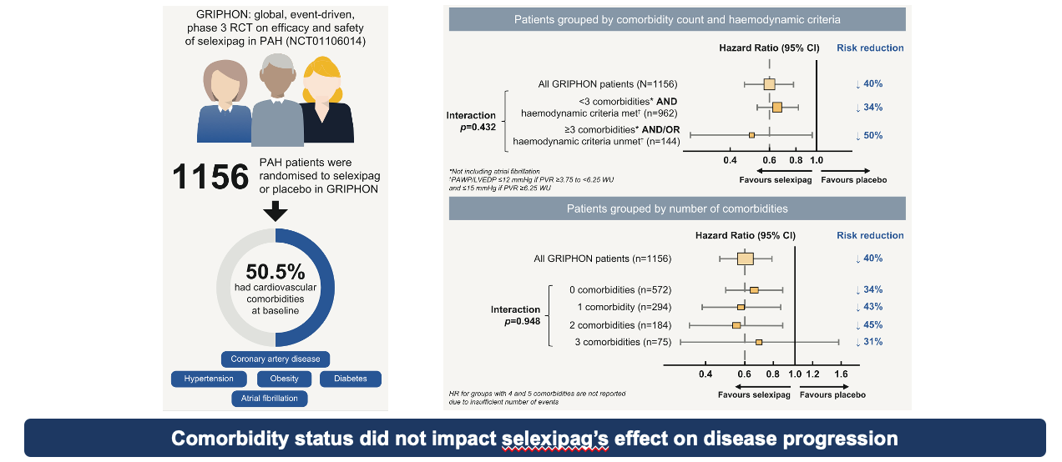
Insights From RCTs: Impact of Comorbidities in GRIPHON
selexipag’s
Rosenkranz S, et al. Eur J Heart Fail. 2022;24(1):205-214.

Slide 10
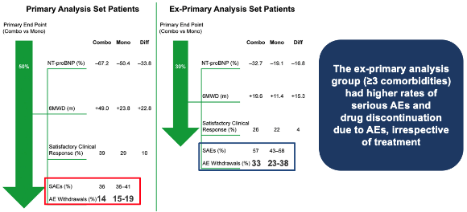
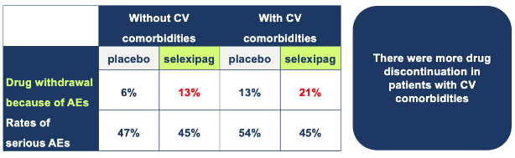
Balancing Benefit and Risk With PAH Treatment in Patients With CV Comorbidities: Insights From AMBITION and GRIPHON
Adverse Events in AMBITION
Adverse Events in GRIPHON
Higher rates of SAEs and drug discontinuations due to AEs
in patients with ≥3 CV comorbidities, regardless of treatment
More drug discontinuations
in patients
with CV comorbidities
McLaughlin VV, et al. J Heart Lung Transplant. 2019;38(12):1286-1295.
Rosenkranz S, et al. Eur J Heart Fail. 2022;24(1):205-214.

Slide 11
What Is the Diagnosis: Janet, Emma, and Bess?
 | Emma | Bess | Janet
Age/FH | 53, FH HPAH | 68 | 75
FC | III | III | III
Obesity Diabetes mellitus Hypertension Paroxysmal AF | -- -- Mild (well controlled) -- | ✔️ ✔️ ✔️ -- | ✔️ ✔️ ✔️ --
History of dyspnea | 6 months worsening | 1 year | 2 years
RVE RV function LAE TR RVSP | Severe Moderate dysfunction -- Moderate 85 mmHg | Mild Mild dysfunction ✔️ Moderate 65 mmHg | Mild Normal ✔️ -- 50 mmHg
RAP mPAP PCWP CO/CI PVR | 12 mmHg 55 mmHg 11 mmHg 4.4/2.75 L/min/m² 10 WU | 14 mmHg 42 mmHg 14 mmHg 5.4/2.7 L/min/m² 5.2 WU | 12 mmHg 33 mmHg 15 5.4/2.8 L/min/m² 3.3 WU
Additional info | ANA/HIV/VQ normal, 380 6MWD, BNP 625 ng/L | -- | --
CV
Comorbid
Echo
RHC

Slide 12
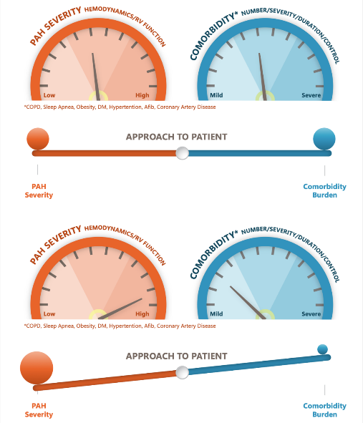
Relationship of Comorbidities With Severity of PAH
Approach while evaluating patients with PAH and comorbidities:
Guage severity of PAH versus burden of comorbid conditions (obesity, uncontrolled HTN, AF, DM, CAD, etc.)
Optimization of comorbid condition should be done as promptly as possible while evaluating the severity of PAH
Sahay S, et al. Am J Respir Crit Care Med. 2024;210(5):581-592.

Slide 13
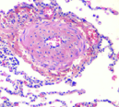

Hemodynamic Profiles of Patients With CV Comorbidities
Group 1
Group 2
Pulmonary arterial hypertension
(PAH)
PH associated with left heart disease
PAH without comorbidity
PAH and CV comorbidities
Left diastolic dysfunction
Combined post- and precapillary PH (Group 2)
Isolated postcapillary PH
(Group 2)
mPAP 20 mmHg
PAWP ≤ 15 mmHg
PVR > 2 WU
PAWP ≥ 18-20 after fluid challenge
PAWP 12-15 mmHg (and PVR < 5 WU)
LA enlargement, others
mPAP 20 mmHg
PAWP > 15 mmHg
PVR > 2 WU
mPAP 20 mmHg
PAWP > 15 mmHg
PVR< 2 WU
Combination therapy
Monotherapy?
Combination Rx?
No PAH therapies

Slide 14
PAH Therapy Decisions
Objective Risk Stratification Score
Comorbidities
Patient Factors
Age, QOL,
Support System
Treatment Choice
Hemodynamics
RV Function on Imaging
Route of Delivery
Side Effect Profile

Slide 15
Summary
PH is common; PAH is rare
  PH more commonly attributable to Group 2/3
Patients with PAH are increasingly diagnosed at older ages with common comorbidities (obesity, DM, hypertension, CHD, lung disease)
Critical to get diagnosis right
  Consider pre-test probability
  Conduct meticulous RHC that might include volume challenge
More recent clinical trials have included patients with PAH and multiple comorbidities, and further analysis shows that these patients benefit from appropriate treatment
Multiple PAH therapeutic options are available; combination therapy is required in most cases
  Remember to optimize comorbidity treatments
Comorbidities should be considered in risk assessment and treatment goals

Slide 16

Have a question for the presenters?
View the right-hand side to type a question for the panel

