Slide 1
Management of Left Heart Disease-Associated PH
Thomas Cascino, MD, MSc
Clinical Instructor
University of Michigan
Brighton, MI
@TomCascinoMD

Slide 2
Overview
Adopting a staging-based treatment approach
Tailoring therapies for PH-LHD through disaggregation to implement a general treatment strategy for PH-LHD in 2024
PH-LHD, pulmonary hypertension associated with left heart disease.

Slide 3
Overview
Adopting a staging-based treatment approach
Tailoring therapies for PH-LHD through disaggregation to implement a general treatment strategy for PH-LHD in 2024
PH-LHD, pulmonary hypertension associated with left heart disease.

Slide 4
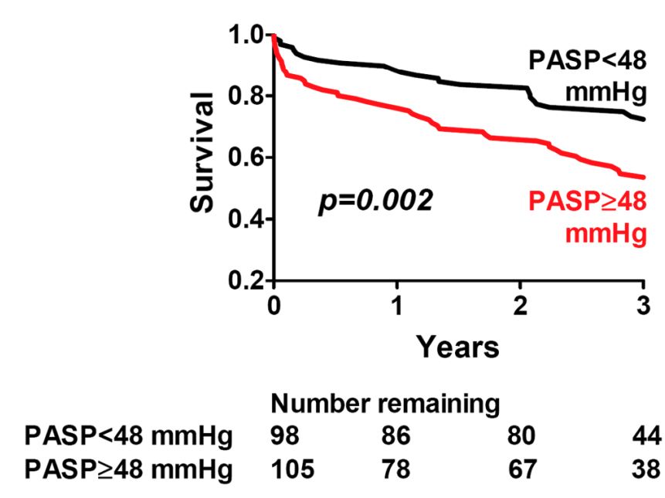
PH Impacts Mortality in Patients With LHD
40,082 VA patients
244 HFpEF patients
Maron BA, et al. Lancet Respir Med. 2020;8(9):873-884. Lam CSP, et al. J Am Coll Cardiol. 2009;53(13):1119-1126.

Slide 5
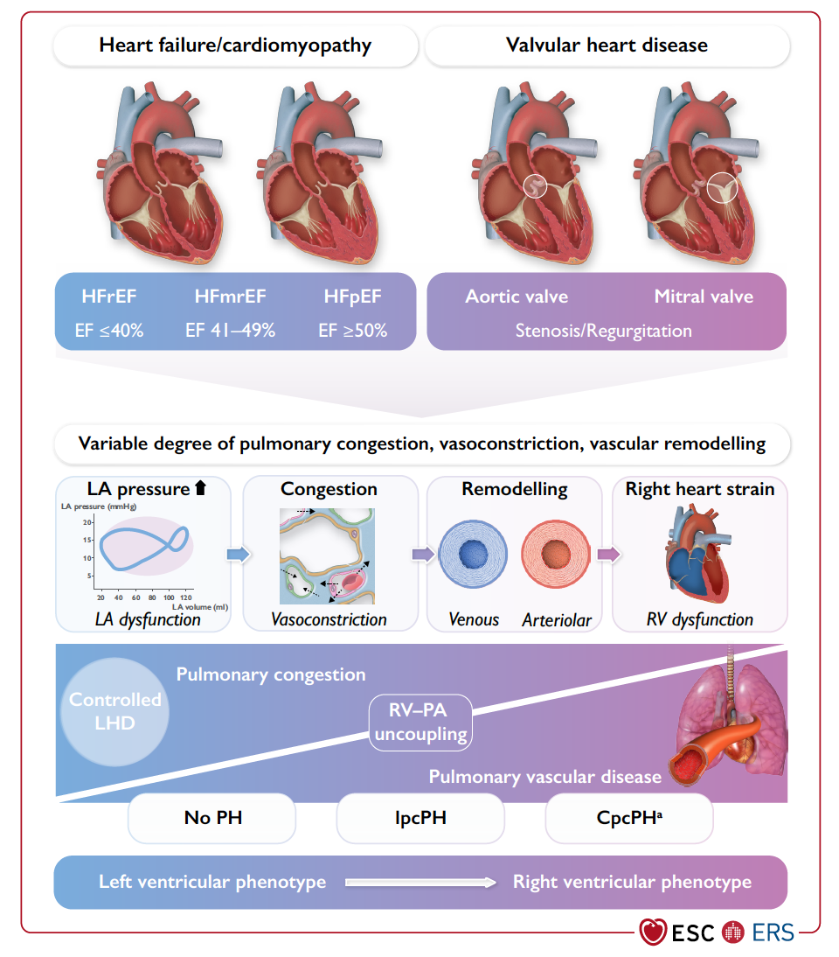
PH Associated With Left Heart Disease Is a Spectrum

Slide 6
Prevention of PH-LHD Is Likely Possible

Slide 7
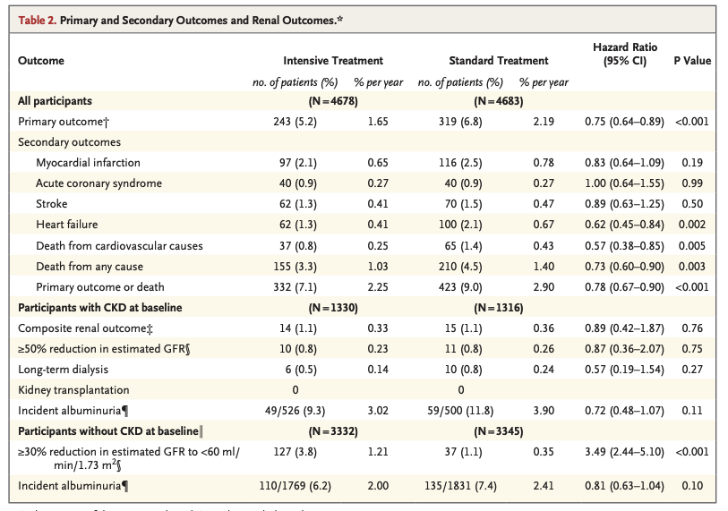
Key Point: We Can Prevent HF!
SPRINT Research Group, et al. N Engl J Med. 2015;373(22):2103-2116. Zelniker TA. Lancet. 2019;393(10166):31-39.

Slide 8
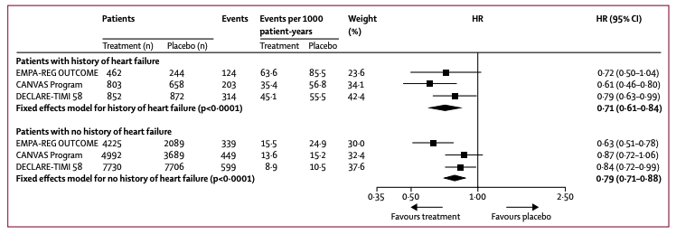
Key Point: We Can Prevent HF!
SPRINT Research Group, et al. N Engl J Med. 2015;373(22):2103-2116. Zelniker TA. Lancet. 2019;393(10166):31-39.

Slide 9
Treat LHD Aggressively Per Guidelines
Cascino TM, et al. J Card Fail. Published online September 26, 2024. doi:10.1016/j.cardfail.2024.09.009

Slide 10
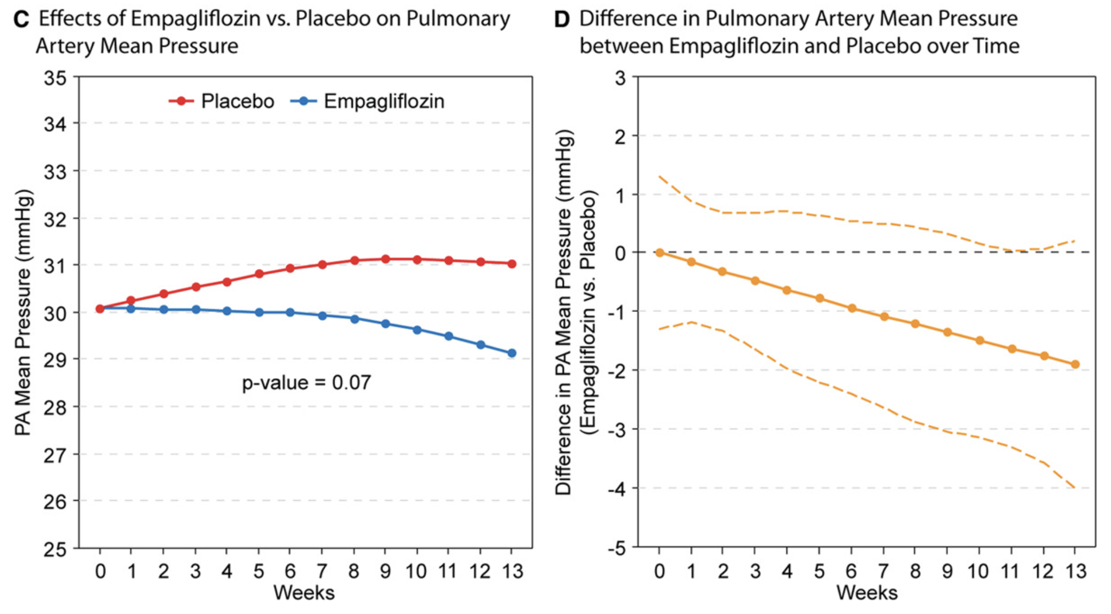
SGLT2i Lower mPAP Independent of Diuretics
EMBRACE-HF RCT
93 patients with heart failure and implanted pulmonary artery pressure sensor randomized to empagliflozin or placebo
Nassif ME, et al. Circulation. 2021;143(17):1673-1686.

Slide 11
Palliative Therapy Can Be Considered for Stage D Patients
Cascino TM, et al. J Card Fail. Published online September 26, 2024. doi:10.1016/j.cardfail.2024.09.009

Slide 12
No FDA-Approved PAH-Specific Medications for PH-LHD!
Isolated post-capillary pulmonary hypertension
Combined post- and pre-capillary pulmonary hypertension
Theoretical risk of of increasing PCWP resulting in pulmonary edema

Slide 13
No FDA-Approved PAH-Specific Medications for PH-LHD!
PDE5 inhibitors:
Previously most promising; trials = mixed results
Endothelin receptor antagonists:
Multiple studies have failed to show benefit
Prostacyclins:
FIRST trial in HF w/reduced LVEF: ↑mortality

Slide 14
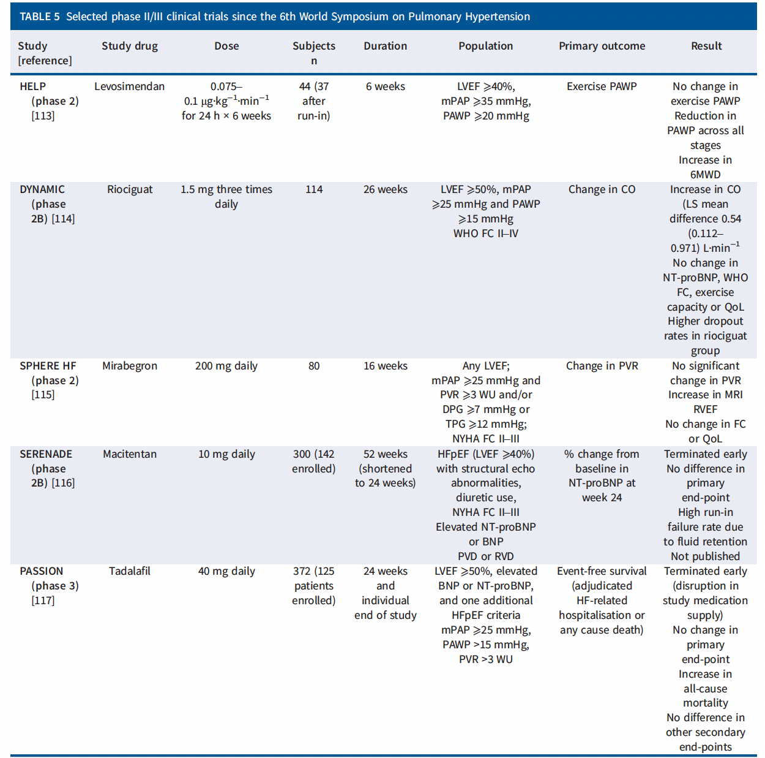
No Large Multicenter Trials That Show Benefit
PASSION RCT
Terminated early (disruption in study med)
No change in primary endpoint
Increase in all-cause mortality
No difference in other secondary endpoints

Slide 15
No Large Multicenter Trials That Show Benefit
PASSION RCT
Terminated early (disruption in study med)
No change in primary endpoint
Increase in all cause mortality
No difference in other secondary endpoints
Reinforced the position that PAH-specific medications
should NOT be used in PH-LHD!!!

Slide 16
Overview
Adopting a staging-based treatment approach
While PH-LHD is associated with increased mortality, PAH-specific medications should NOT be prescribed routinely
Tailoring therapies for PH-LHD through disaggregation to implement a general treatment strategy for PH-LHD in 2024

Slide 17
Overview
Adopting a staging-based treatment approach
While PH-LHD is associated with increased mortality, PAH-specific medications should NOT be prescribed routinely
Tailoring therapies for PH-LHD through disaggregation to implement a general treatment strategy for PH-LHD in 2024

Slide 18
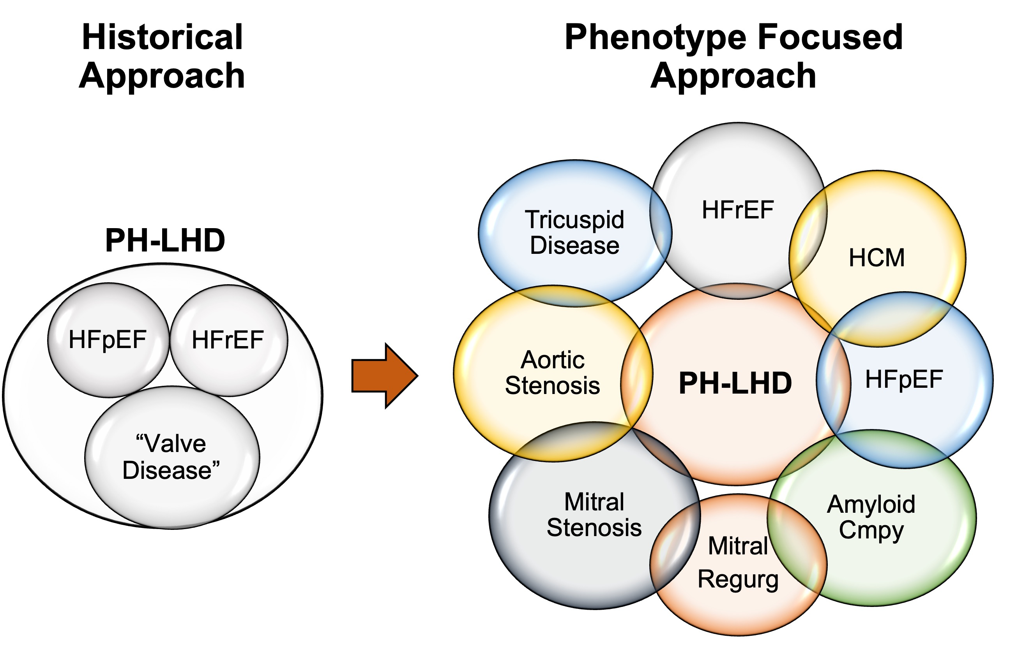
Treatment of LH Disease-Associated PH
Step 1: Accurate diagnosis of etiology to PH-LHD substrate and clinical decision-making
Make sure not dealing with a “zebra”

Slide 19
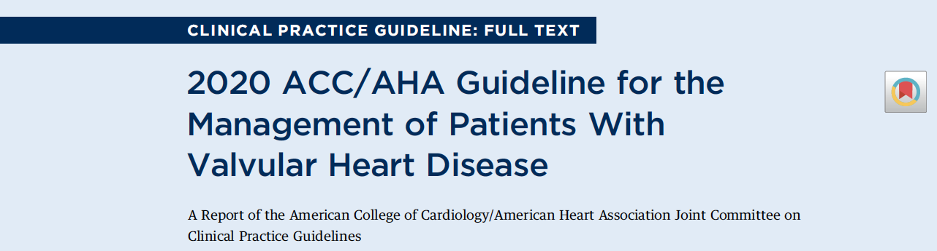
Treatment of LH Disease-Associated PH
Step 1: Accurate diagnosis of etiology to PH-LHD substrate and clinical decision-making
Make sure not dealing with a “zebra”
Step 2: Treat the underlying etiology of left heart disease

Slide 20
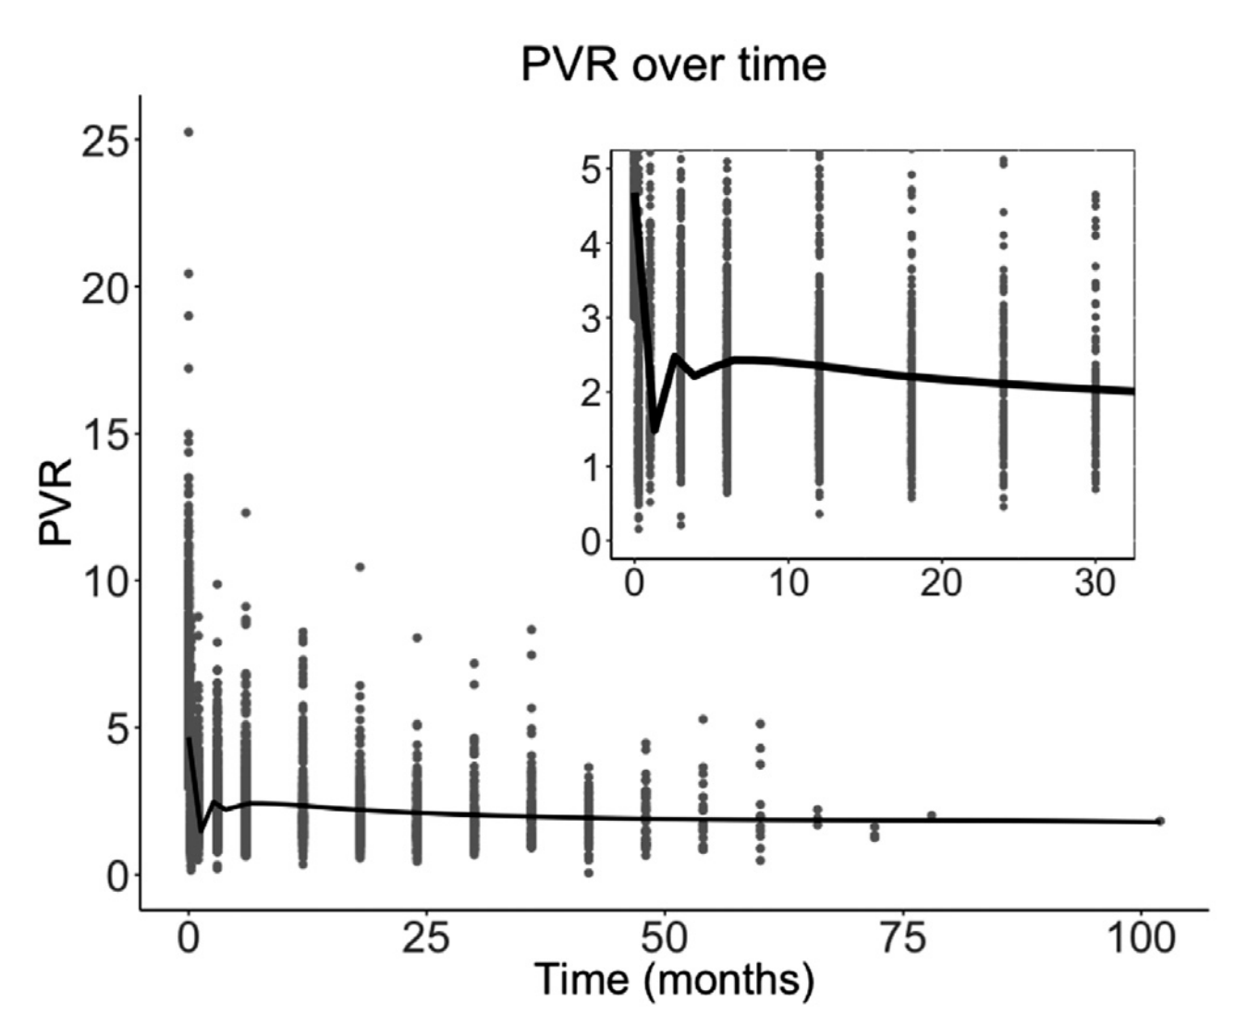
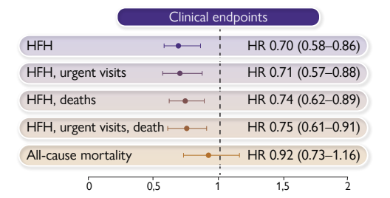
Treatment of LH Disease-Associated PH
Step 1: Accurate diagnosis of etiology to PH-LHD substrate and clinical decision-making
Make sure not dealing with a “zebra”
Step 2: Treat the underlying etiology of left heart disease
Step 3: Diuretics to optimize volume status and lower left atrial pressure
1,581 LVAD patients in STS Intermacs Registry with PVR > 3 WU
1,898 patients enrolled in RCTS for pulmonary pressure-guided therapy for HF
CHAMPION, GUIDE-HF and MONITOR-HF trials

Slide 21
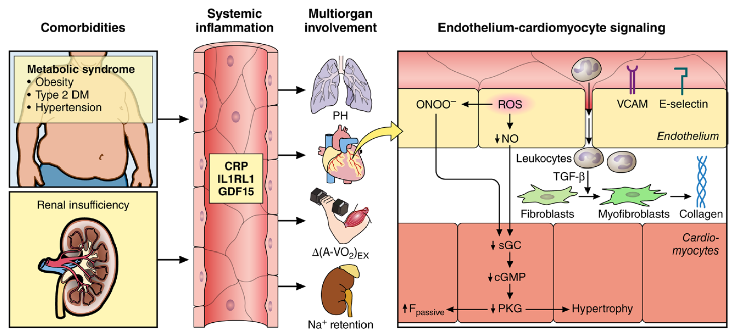
Treatment of LH Disease-Associated PH
Step 1: Accurate diagnosis of etiology to PH-LHD substrate and clinical decision-making
Make sure not dealing with a “zebra”
Step 2: Treat the underlying etiology of left heart disease
Step 3: Diuretics to optimize volume status and lower left atrial pressure
Step 4: Treat comorbidities aggressively
Aging
Atrial Fibrillation
Shah SJ, et al. Circulation. 2016;134(1):73-90.

Slide 22
Treatment of LH Disease-Associated PH
Step 1: Accurate diagnosis of etiology to PH-LHD substrate and clinical decision-making
Make sure not dealing with a “zebra”
Step 2: Treat the underlying etiology of left heart disease
Step 3: Diuretics to optimize volume status and lower left atrial pressure
Step 4: Treat comorbidities aggressively
Step 5: Exercise training, HF education, chronic disease management programs
Step 6: Enroll in clinical trials

Slide 23
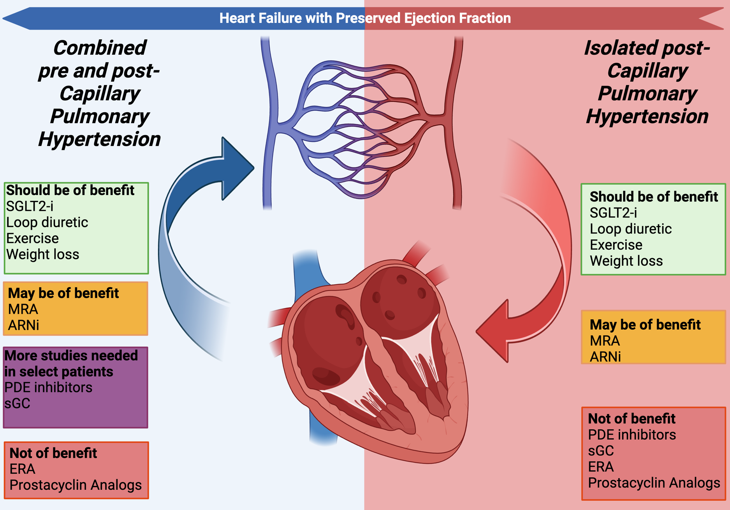
Summary

Slide 24
Overview
Adopting a staging-based treatment approach
While PH-LHD is associated with increased mortality, PAH-specific medications should NOT be prescribed routinely
Tailoring therapies for PH-LHD through disaggregation to implement a general treatment strategy for PH-LHD in 2024
Ensure accurate diagnosis of etiology, treat the underlying cause, optimize left atrial pressure, and enroll in clinical trials

